Slide 1


Complete Outside Broadcast Kit
User/Presenter Training

Slide 2
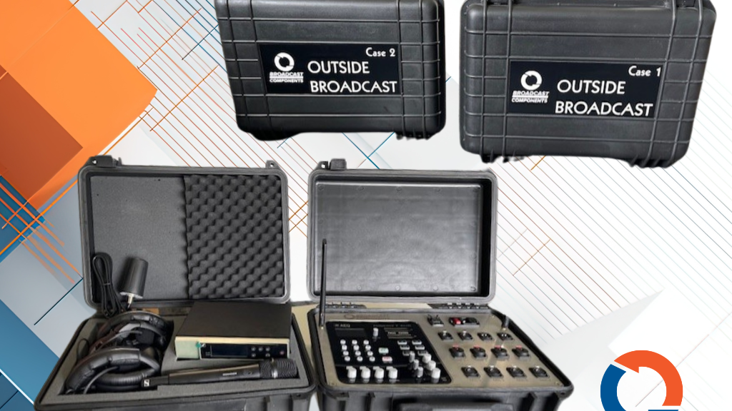
Congratulation on your new complete Outside Broadcast Kit

Slide 3
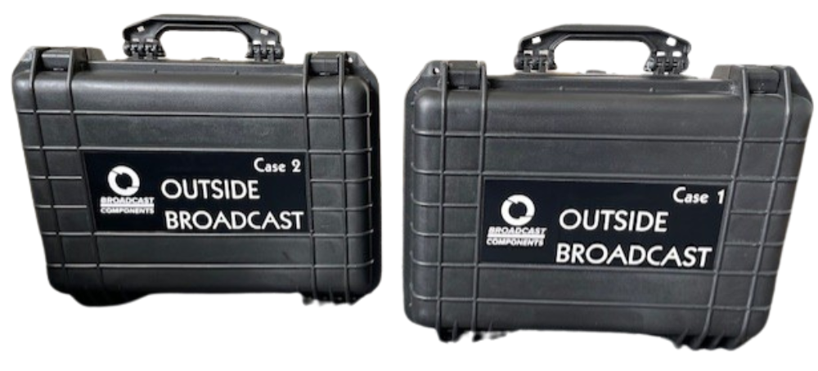
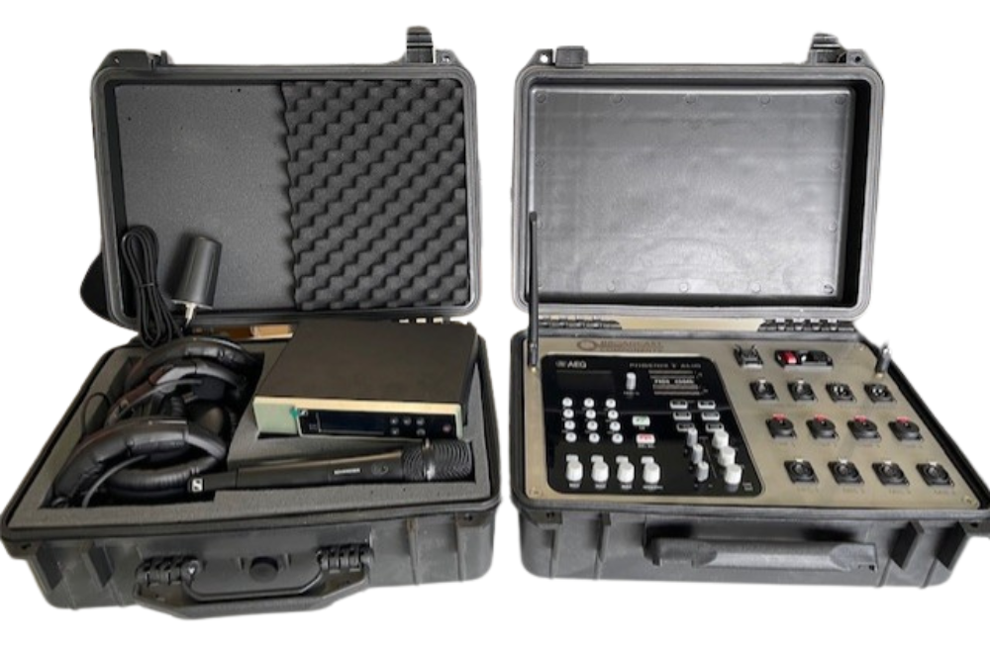
The Kit
Notes:
This Plug and play Complete Outside Broadcast (OB) Kit is easy to use. Designed and produced by Broadcast Components, this kit has everything you need for your next OB event in two handy cases.

Slide 4
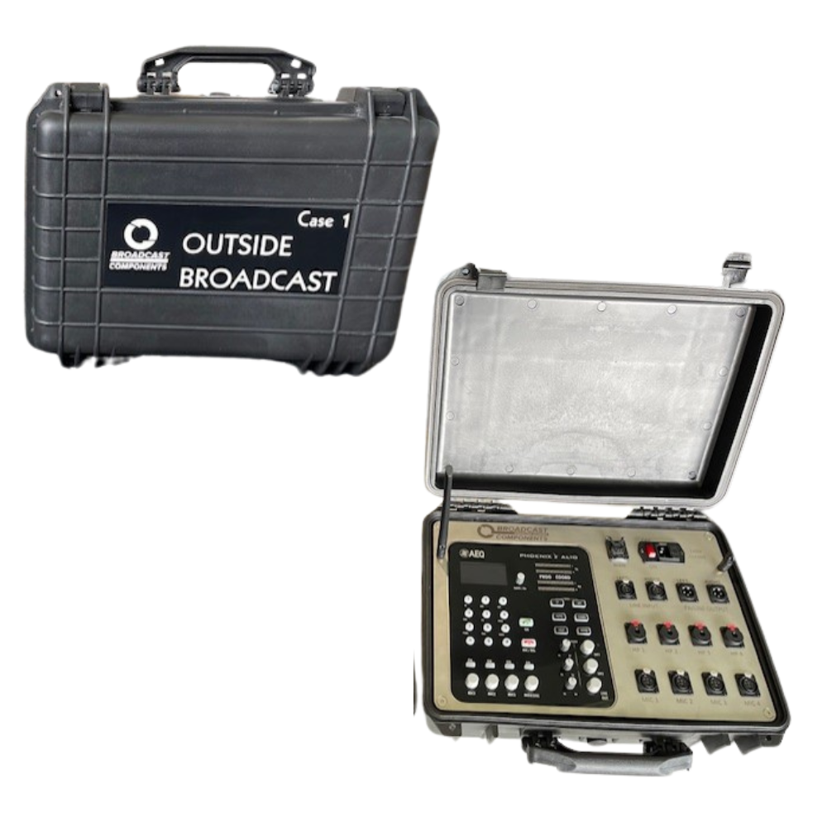
Case 1: Codec
Contains:
  Portable Codec Mixer – AEQ Phoenix Alio
  Dual SIM Modem – Rut950
  3 x MIC inputs
  1 x MIC input or Line in
  4 x Headphone inputs
  2 x Stereo inputs
  WAN Port

Slide 5
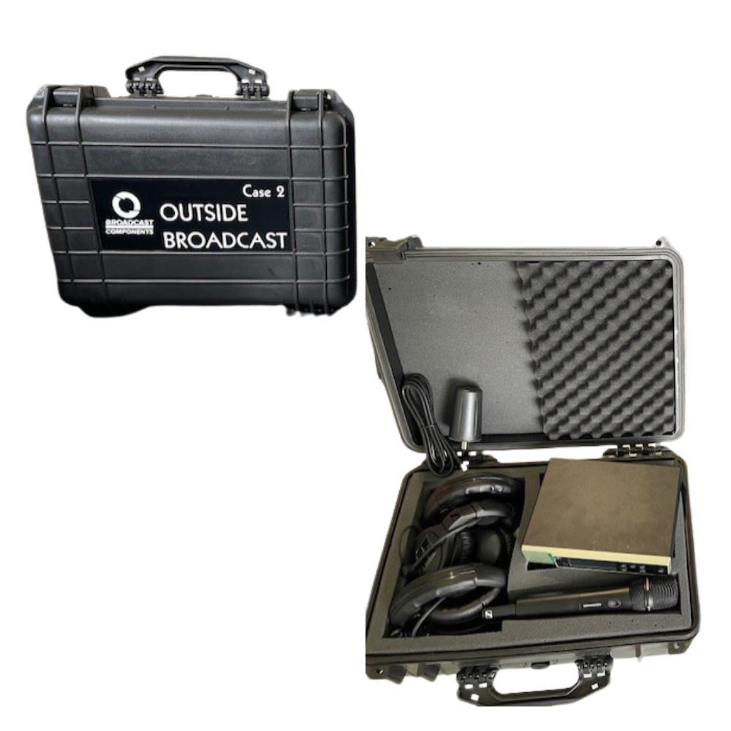
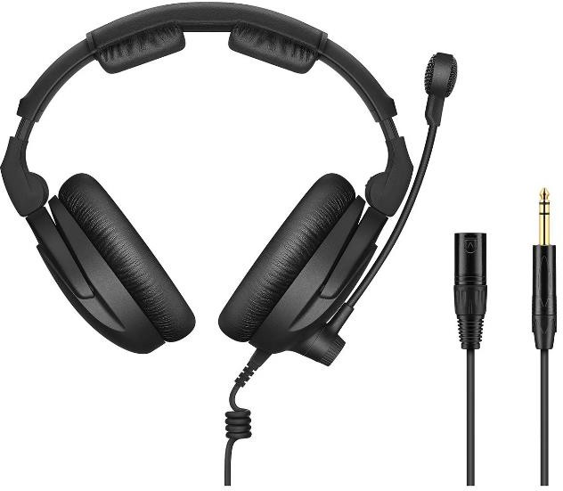
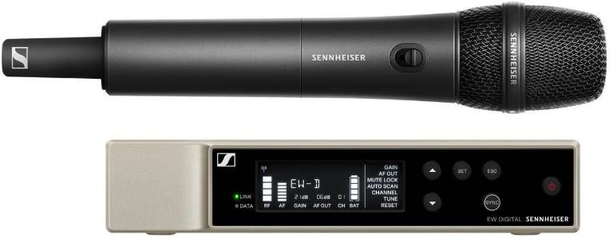
Case 2: Audio
Contains:
  3 x Headsets – Sennheiser HMD 300 Pro
  Wireless microphone and receiver – Sennheiser EW-D series
  Low Profile Antenna – long cable

Slide 6
Case 1: Codec -Alio

Slide 7
A: OLED Display
Notes:
The screen is divided into 7 columns. From left to right, the first 4 correspond to the 4 active inputs. The first three are always MIC1, MIC2, MIC 3. The Fourth can correspond to MIC4 of LINE IN. This can be selected through the MIC4/LINE menu or through the “#” shortcut key in the numeric keyboard. (The label under the level bar changes accordingly). The last three columns correspond to the outputs HP1, HP2 and OUT, as indicated under each level bar.
Each bar represents a relative mix level or output volume.
Above each output level bar there is a label showing “PGM” or “CUE”. These indicate what program bus is being monitored on each of the output.

Slide 8
B: NAVIGATION / CHANNEL ENCODER (“NAVI/CH”)
Rotary Encoder
Browse through the different menus of the OLED multifunction screen
Clockwise → Down,
Anti-clockwise → Up
Press = Enter
Notes:
This rotary encoder allows the user to browse through the different menus of the OLED multifunction screen. Turning the dial changes the selection amongst the options present, moving the highlighting up and down. When the encoder is turned clockwise, the option is moved down, and turning it anti-clockwise, the option select is moved up.
Pressing down on the rotary encoder is equivalent to ENTER, validating the highlighted selection at that moment.

Slide 9
C: Vu Meters
2 x Stereo Vu meters
Top – Level of the Transmit (TX) signal
2nd – Level of reception (RX)
Ideal – 0 db – First orange
Notes:
There are two stereo Vu meters. The top two indicates the level of the TX signal and the second the level of reception, RX.
Each Vu meter consists of 2 bars of 20 LEDs each. From right to left, the first three LEDs are red followed by four orange, with the remainder are green. The presence if audio is denoted at -36dBV when the first green LED is illuminated.
0 dB: The 0 dB mark on the VU meter represents the reference level, which is usually the maximum level the meter can accurately measure without distortion. It indicates the ideal level where the audio signal is neither too low nor too high.
-3 dB: A level of -3 dB indicates that the audio signal is roughly half the maximum level. It is considered a conservative level to avoid distortion and leave headroom for dynamic peaks in the audio.
-20 dB: A level of -20 dB represents a relatively low signal level, often used as a reference for background noise or quiet audio passages. It helps ensure that the noise floor is sufficiently low.

Slide 10
E: Input Controls
Rotary encoder for each
Pushbutton – See next slide
Activation/Routing Key
  Pushed – RED = ON = Program
  Off = CUE (prelisten)
Notes:
Each input has an associated rotary encoder with pushbutton and an activation/routing key (ON). If the rotary encoder is turned, the mix gain to the selected bus is altered for that input, between mute (-infinity) and +18 dB. The level bar on the OLED display shows an indication of this level.
The ON button allows the user to select which bus the associated input will be sent to. When it is off, pressing it will turn the button RED-illuminated, indicating that the input is sent to PROGRAM transmission channel. Press is again once and it will turn off, and the input will only be available locally in the CUE pre-listen bus.
When several inputs have their ON button illuminated in RED, they will be mixed (each source according to the selected mix level).

Slide 11
E: Input Controls
Pushbutton – Configuration Menu
Notes:
When the encoder button is pressed, access to the associated input’s configuration menus is opened. Here you can configure the corresponding gain, equalization (bass/treble), activation of the 12V Phantom supply and panorama control. In the case of MIC4/ LINE input, the user will also be able to select which input is used; when working in line mode, panorama control changes to balance control.

Slide 12
E: Input Controls – Config Menus
Notes:
The corresponding input encoder can be used to navigate within the menu, or alternatively, the “NAVI/Ch” rotary encoder can also be used. The “BACK” option in each menu or the “ESC/DEL” key can be used to cancel and go back.

Slide 13
E: Input Controls – MIC4/LINE
Different Config Menu
LINE – PC or Mobile phone connection
2 Ways to select the MIC4 or LINE input:
  Rotary encoder-menu or #
Notes:
The corresponding input encoder can be used to navigate within the menu, or alternatively, the “NAVI/Ch” rotary encoder can also be used. The “BACK” option in each menu or the “ESC/DEL” key can be used to cancel and go back.

Slide 14
F: Output Controls
3 x Stereo Outputs
  2 x Headphones
  1 x Line output
Controlled by Output level encoder
Tx/RX level balance potentiometer
Notes:
The unit has 3 stereo outputs: 2 for headphones, able to drive both high and low impedance models with ¼” TRS jack connectors and 1 balanced line output with 2 male XLR connectors.
Each output has labelled control section (“HP1”, “HP2”and “LINE OUT”)
TX/ RX level balance potentiometer: Allows the user to continuously adjust which ratio of the correspondence output comes from the channel local transmission (TX, send) and what comes from the same channel reception (reception, RX). When in the central position, equal levels of RX and TX will be listening to, both with 6dB attenuation.
Output level Encoder: Adjusts the listening level of the corresponding output. It will be displayed on the OLED with level bars.
Pressing the output level encoder button cyclically selects the source bus for that output bus, between CUE (Sourced LED off), or PROG (source LED illuminated red). The display will show a label above the corresponding F
level bar:
The HP1 button controls headphones in 1 and 2 and HP2 controls headphones in 3 and 4.

Slide 15
G: Function Keys
IP
SIP
AUTO
CODEC
HELP
MENU
Notes:
The unit’s operational keys are completed by 6 illuminated functions keys located at the right area of the Alio front panel. Some of these keys (“IP”, “SIP”, “AUTO”, “CODEC”) configure parameters or operating modes for the currently active channel only. “HELP” and “MENU” keys are associated to functions that are common to the unit. Your unit is preconfigured to select the appropriate function and so you will not need to change these.

Slide 16
Case 1: Codec – Alio
Alio, power supply, modem (SIM), connections
Setup → Plug and play
(Will Automatically connect to studio/station)
Connect power cable and then turn on, wait 3 minutes→broadcast

Slide 17
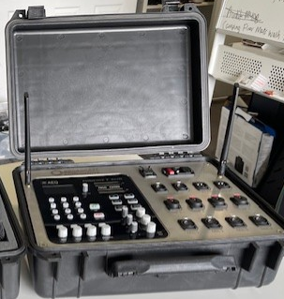
Case 1 Codec: Alio
Open case
Lift Mobile Antenna up = better reception

Slide 18
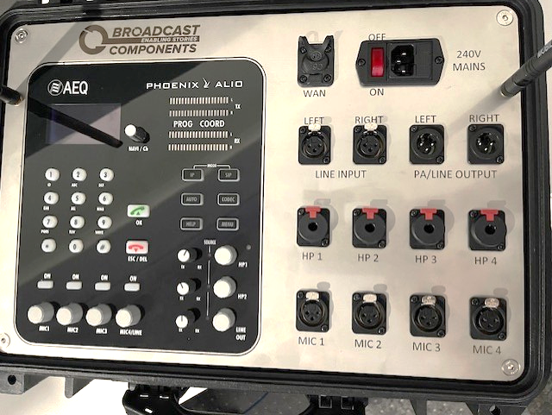
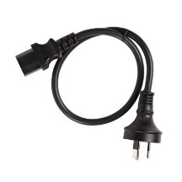
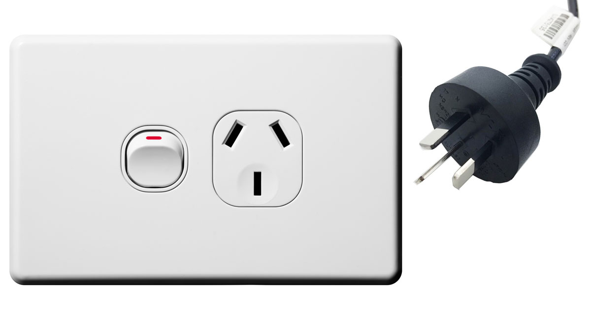
Case 1 Codec: Alio
Connect power cable and turn ON

Slide 19
Turning the Alio on
Wait 3 minutes

Slide 20
Turning the Alio on
ON

Slide 21
Turning the Alio on
AEQ screen

Slide 22
Turning the Alio on
Phoenix Alio

Slide 23
Turning the Alio on
Bars

Slide 24
Turning the Alio on
CONNECTING

Slide 25
Turning the Alio on
CONNECTED – NO DATA

Slide 26

Turning the Alio on
CONNECTED

Slide 27
Alio Codec – Connected –Ready for Broadcast
CONNECTED
RX Vu Meters
PROG – Red

Slide 28
Connecting Headphones & Mics
HMD 300 Pro Headsets
Notes:
You get 3 in case 2. The HP cable (TRS) goes to the HP jack and then XLR connect to the mic input ports

Slide 29
Connecting Headphones & Mics
Sennheiser Wireless Mic and receiver (EW-D)

Slide 30
Sennheiser Receiver
Connect the rod antennas.

Slide 31
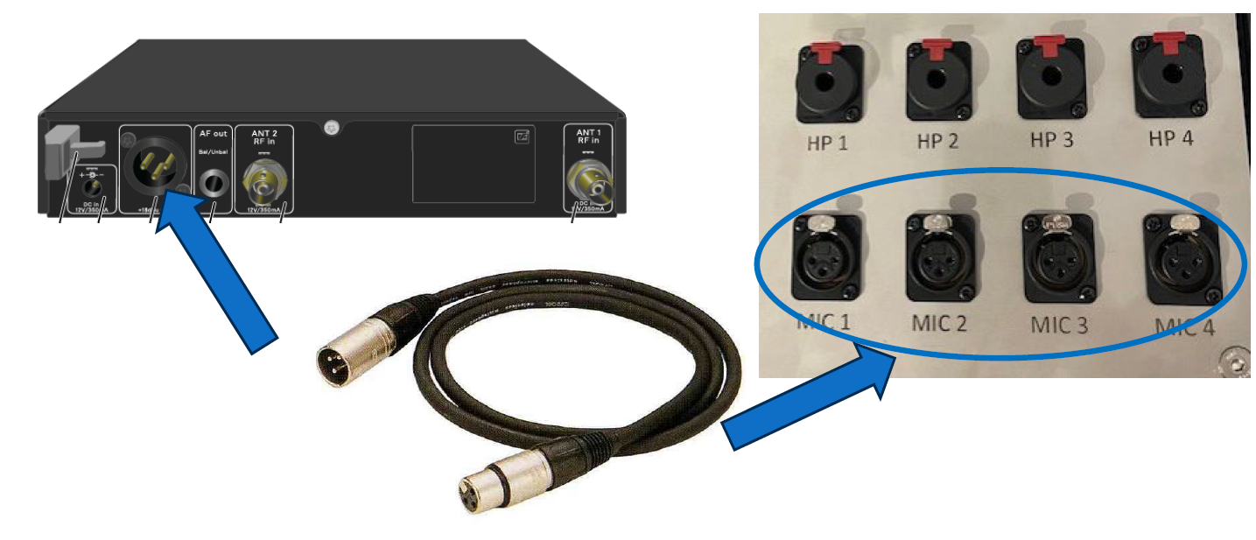
Sennheiser Receiver
2. Connect to one of the Mic ports on the OB face using the supplied XLR cable.

Slide 32
Sennheiser Receiver
3. Connect the receiver to its power supply

Slide 33
Sennheiser Receiver
4. Switch Receiver ON

Slide 34
Sennheiser Wireless Mic
Ensure there are 2 x AA charged batteries in the Mic

Slide 35
Sennheiser Wireless Mic
Turn on the wireless Microphone- short press the red button on the bottom of the mic.
The LINK Led lights up and switches on.

Slide 36
Connecting the Receiver and Wireless Mic
For connection →must be synchronized with each other (=same frequency).
Step 1: Set a free frequency.
We recommend using the AUTO SCAN function
Notes:
To establish a connection the devices must be synchronized with each other. To do this successfully both devices must have the same frequency.

Slide 37
AUTOSCAN
Menu – select AUTOSCAN
Finds free frequencies
Next free frequency displayed- SET
Notes:
Under the AUTO SCAN menu item on the receiver, you can perform an automatic frequency scan of your area. This enables you to easily find and assign the free radio frequencies.
The scan starts at the lowest frequency in the device’s frequency range.
Open the AUTO SCAN menu item. The scan starts automatically. The next free frequency is shown on the display.
Press the SET button to accept the displayed frequency. You will then be returned to the main view or advanced view. or
➢ Press the UP or DOWN button to display the next free frequency above or below the current frequency. or
➢ Press the ESC button to cancel the scan. The previous frequency remains unchanged.

Slide 38
Connecting the Receiver and Wireless Mic
Step 2: Pairing a receiver with a transmitter (wireless mic)
Short-press (less than 2 seconds) the SYNC button on the receiver.
The blue DATA LED flashes

Slide 39
Connecting the Receiver and Wireless Mic
➢ Short-press (less than 2 seconds) the SYNC button on the transmitter (wireless mic)
The blue DATA LED flashes.
Once the link is established, the LINK LED on both units will light up green.

Slide 40
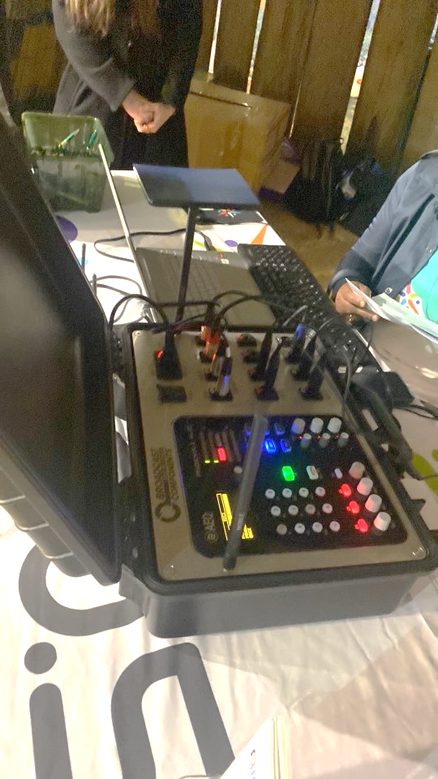
Ready to Broadcast
Ensure Mobile Antennas are pointing upwards
Alio says CONNECTED
VU Meters of RX showing signal from station connection
Mic and Headphones routed to ON-Program – Red lights
At Station OB Fader is ON and OPEN

Slide 41
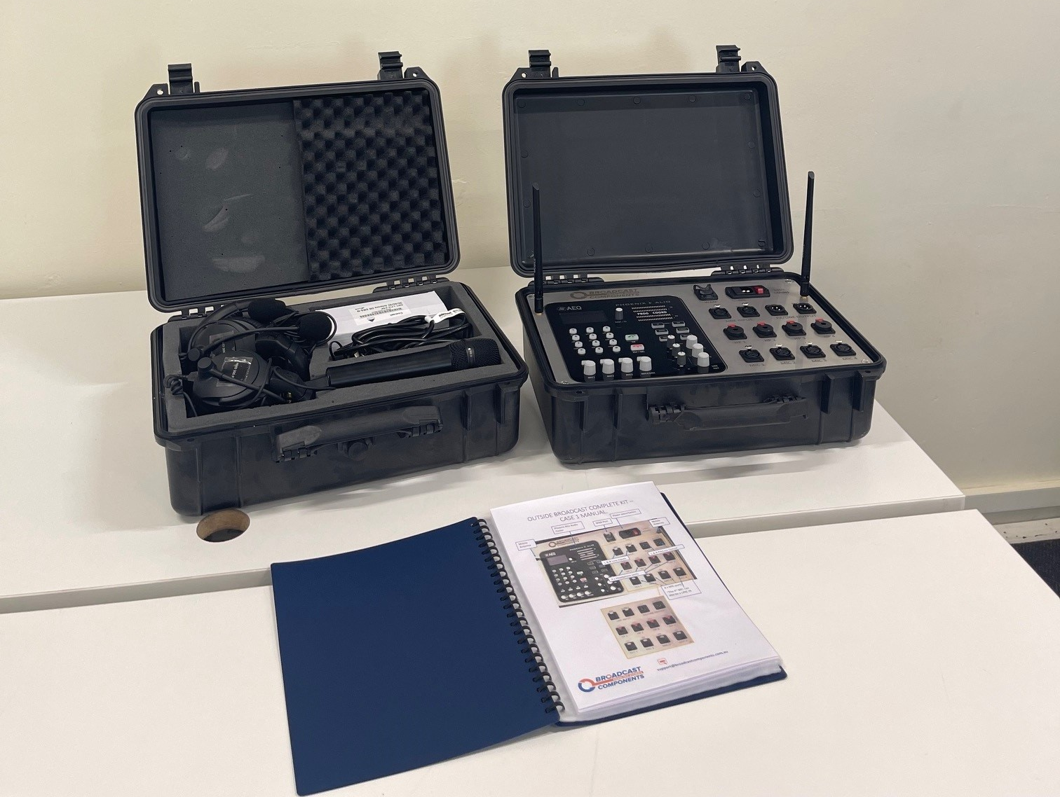
After broadcast
Turn kit OFF – Main Rocker power switch
Collapse Mobile Antennas
Disconnect Mics and Headphones, →
  Headphones –press and hold red button to release and pull TRS connector
  Mics – press the silver release button and pull XLR connector
Pack away all equipment – See inventory list

Slide 42
Troubleshooting: Connected- No Data
Have you waited 3 minutes?
Is there data on SIM card?
Is the codec at the station (Venus) turned on?

Slide 43
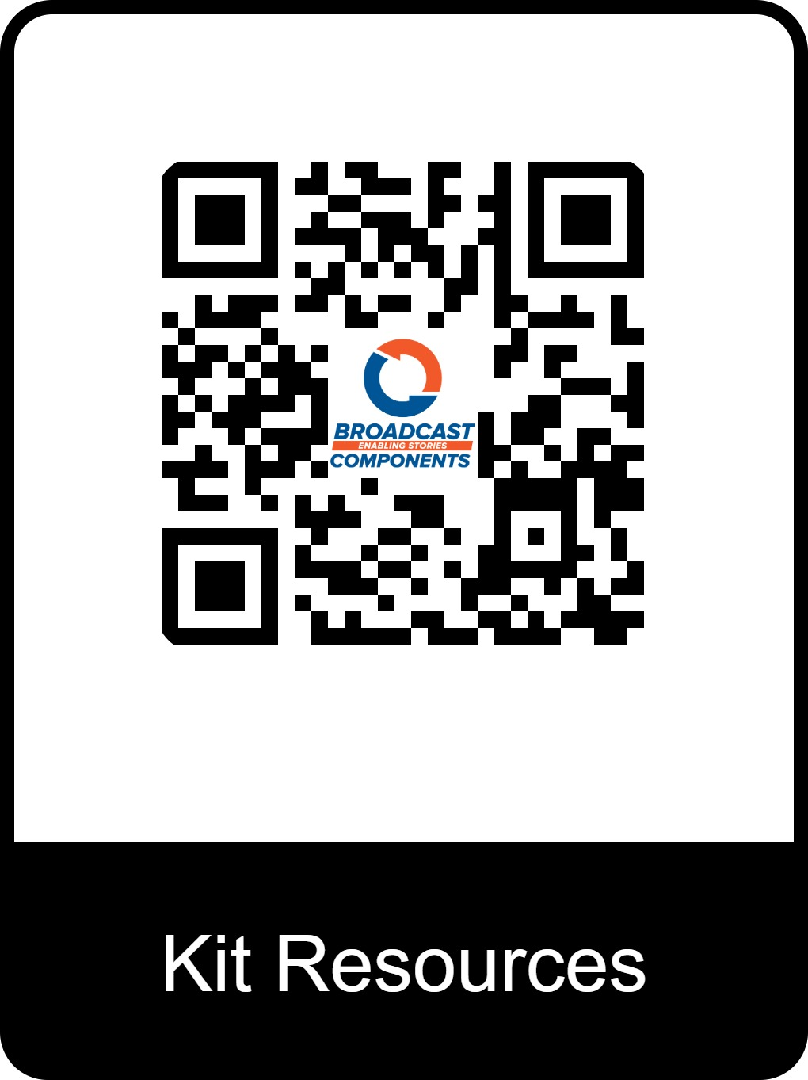
Support
User Manual
Scan QR code – Kit Resources
Email: support@broadcastcomponents.com.au

